Slide 1
Data Breaches at HIPAA Covered Entities Paul Carson Springboard Capstone 12.2017

Slide 2
Data Breaches at HIPAA Covered Entities
Project Approach
Overview and Scope
Data
Data clean up
Preliminary exploration
Machine learning models
Conclusions and Recommendations

Slide 3
Overview and Scope
Overview
Organizations covered under Health Insurance Portability and Accountability Act (HIPAA) are required to provide notification of breaches (HIPAA,2017)
Ten year period from 10/2007 to 10/2017 identifies 2046 reported breaches for a total of 175,654,582 Individuals Affected (OCR portal,hhs.gov)
Data breaches pose threats under multiple risk categories
Identifying threat vectors likely to lead to loss provides the organization an opportunity to harden defenses
Goal
Goal is to utilize machine learning to identify scenarios likely to lead to large data breaches
Utilized R programming language to clean, analyze and model data
Notification to “provide notification following a breach of unsecured protected health
Overview
Organizations covered under Health Insurance Portability and Accountability Act (HIPAA) are required to proved notification of breaches (HIPAA,2017)
Ten year period from 10/2007 to 10/2017 identifies 2046 reported breaches for a total of 175,654,582 Individuals Affected (OCR portal,hhs.gov)
information” (HIPAA, 2017).
Validation refers to the act of ensuring the non-monetary data has been produced in a manner that meets the required structure and meaning of the process/program for which it will be used.
Why you?
In most cases, you were selected for participation because you/your team ultimately own the care of the data you are balancing/validating. It’s in your best interest to ensure the data coming over is accurate and effective for day to day processing purposes.
In some cases, you’ve been drafted for a one time event. We simply need your help.

Slide 4
Data
Downloaded records from the Office of Civil Rights Portal (www.hhs.gov)
Identified the Individuals Affected as the dependent variable
Initial data set comprised of 9 variables:
Name of Covered Entity
State
Covered Entity Type (e.g. healthcare provider, health plan)
Individuals Affected
Breach Submission Date
Type of Breach
Location of Breached Information (e.g. paper, network server, etc.)
Business Associate Present (yes/no)
Web Description
Notification to “provide notification following a breach of unsecured protected health
Overview
Organizations covered under Health Insurance Portability and Accountability Act (HIPAA) are required to proved notification of breaches (HIPAA,2017)
Ten year period from 10/2007 to 10/2017 identifies 2046 reported breaches for a total of 175,654,582 Individuals Affected (OCR portal,hhs.gov)
information” (HIPAA, 2017).
Validation refers to the act of ensuring the non-monetary data has been produced in a manner that meets the required structure and meaning of the process/program for which it will be used.
Why you?
In most cases, you were selected for participation because you/your team ultimately own the care of the data you are balancing/validating. It’s in your best interest to ensure the data coming over is accurate and effective for day to day processing purposes.
In some cases, you’ve been drafted for a one time event. We simply need your help.

Slide 5
Data Clean Up
Removed the web description variable. It has a lot of verbiage that isn’t relevant to this project and is out of scope
Identified State column also included U.S. Territories and edited to reflect
Changed format of Breach Submission Date from character to date
Reviewed for Null and NA values and replaced with dummy variables as needed
Establish a new variable, Impact Level, based on Individuals Affected
High Impact >=3000 Individuals Affected in the breach
Low Impact < 3000 Individuals Affected in the breach
Overview
Organizations covered under Health Insurance Portability and Accountability Act (HIPAA) are required to proved notification of breaches (HIPAA,2017)
Ten year period from 10/2007 to 10/2017 identifies 2046 reported breaches for a total of 175,654,582 Individuals Affected (OCR portal,hhs.gov)
information” (HIPAA, 2017).
Validation refers to the act of ensuring the non-monetary data has been produced in a manner that meets the required structure and meaning of the process/program for which it will be used.
Why you?
In most cases, you were selected for participation because you/your team ultimately own the care of the data you are balancing/validating. It’s in your best interest to ensure the data coming over is accurate and effective for day to day processing purposes.
In some cases, you’ve been drafted for a one time event. We simply need your help.

Slide 6
Preliminary Exploration
Reviewed Distribution of Individuals Affected:
Note, the extreme high values have a dramatic impact on the mean
Most events are less than 7800 Individuals Affected (<3rdQu)
Individuals Affected by year:
Overview
Organizations covered under Health Insurance Portability and Accountability Act (HIPAA) are required to proved notification of breaches (HIPAA,2017)
Ten year period from 10/2007 to 10/2017 identifies 2046 reported breaches for a total of 175,654,582 Individuals Affected (OCR portal,hhs.gov)
information” (HIPAA, 2017).
Validation refers to the act of ensuring the non-monetary data has been produced in a manner that meets the required structure and meaning of the process/program for which it will be used.
Why you?
In most cases, you were selected for participation because you/your team ultimately own the care of the data you are balancing/validating. It’s in your best interest to ensure the data coming over is accurate and effective for day to day processing purposes.
In some cases, you’ve been drafted for a one time event. We simply need your help.
Min | 1st Qu | Median | Mean | 3rd Qu | Max
500 | 993 | 2,352 | 88,446 | 7,704 | 78,800,000
Year | Totals
2009 | 134,773
2010 | 5,932,276
2011 | 13,150,298
2012 | 2,808,042
2013 | 6,939,276
2014 | 12,682,073
2015 | 113,267,174
2016 | 16,655,090
2017 | 4,085,580

Slide 7
Preliminary Exploration Cont.
Large numbers on the tail make the data difficult to visualize
Filtered down to look at the first 3 quartiles (<7800 Affected)
Histogram of Individuals Affected by count of Primary Breach:

Slide 8
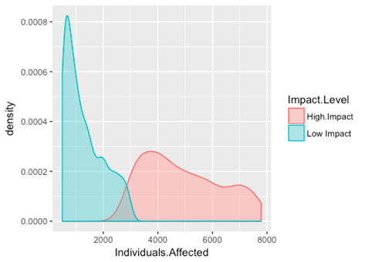
Preliminary Exploration Cont.
Density Plot
Indicates most low impact breaches occur with less than 1000 Individuals Affected
High level breaches are concentrated around 4000 Individuals Affected and tail off to the higher numbers

Slide 9
Preliminary Exploration Cont.
Box Plot of Individuals Affected by Primary Breach
Note how the means tend to be on the lower side of the spectrum with tail values on the extremes

Slide 10
Machine Learning Models
Much of the data is categorical (e.g. Primary Breach, Business Associate present, etc.)
Decided on pursuing a decision tree machine learning model
Data construct
Established Training and Test data sets from 2016.
Used randomly pulled values for 70% as Training data for model and remaining 30% as Test data
Decision tree models take the training data and use it to learn to predict certain outcomes
For this model, the goal is to be able to predict which sequence of events will likely lead to a high impact data breach

Slide 11
Machine Learning Models Cont.
Decision trees can be easy to follow
Each node box displays the classification, probability of each class at that node and the percentage of observations used in that node
Example: First Node is 100% of the data set and predicts 57% will be Low Impact

Slide 12
Machine Learning Models Cont.
Confusion matrix identifies the number of correct predictions, false positives and false negatives
This model correctly identified 16 High Impact and 41 Low Impact events for a total of 57 out of 99 attempts or 58% of the time
 | Predict Tree HI | Predict Tree LI
High Impact | 16 | 26
Low Impact | 16 | 41

Slide 13
Machine Learning Models Cont.
To see if I could improve on the prediction, I applied a random forest model as well
It takes the same approach as the decision tree but plants a forest of trees to identify the most likely outcome
Using the same Training and Test data, the confusion matrix indicates the model is correct 61/99 times or 61.62%; slightly better than the single tree
 | Predict Tree HI | Predict Tree LI
High Impact | 21 | 17
Low Impact | 21 | 40

Slide 14
Machine Learning Models Cont.
To see if I could improve on the prediction, I applied a random forest model as well
It takes the same approach as the decision tree but plants a forest of trees to identify the most likely outcome
Using the same Training and Test data, the confusion matrix indicates the model is correct 61/99 times or 61.62%; slightly better than the single tree
 | Predict Tree HI | Predict Tree LI
High Impact | 21 | 17
Low Impact | 21 | 40

Slide 15
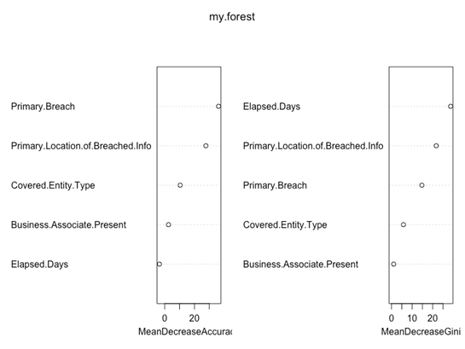
Machine Learning Models Cont.
Below uses different metrics to identify which variables were most important to the model’s accuracy
Of note, what type of breach and where the breached data is located appear to be critical to the prediction

Slide 16
Conclusions and Recommendations
Analyzing the data we were able to identify that many breaches are not catastrophic and that the mean is dramatically impacted by outliers
What kind of breach and where the data is located carry the greatest ability to predict whether it is a high or low impact breach
Recommend increasing usability of the model by making it interactive. This will facilitate informed decision making for data storage, staffing and cyber security efforts
Recommend incorporating this into company’s risk analysis monitoring platform
Recommend implementing a matrix to penalize low impact predictions that are actually high impact events

